Slide 1
Evaluating and Classifying Water Quality using Machine Learning Technique
BATCH A8
ANANDHA LAKSHMI P
GOWTHAMI D
HARITHA R

Slide 2
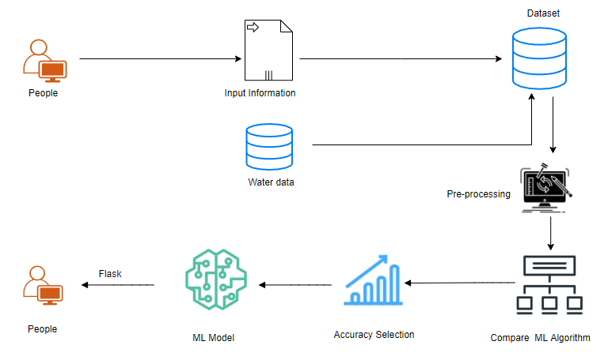
SYSTEM ARCHITECTURE
Sensors

Slide 3
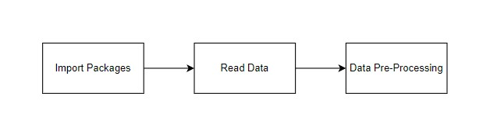
SYSTEM ARCHITECTURE
Data Pre-processing
Finding duplicate values , and it does the process of removing duplicate values, it focus on probably the biggest data cleaning task, missing values and it able to more quickly clean data, detect missing values and do some basic imputation and detailed statistical approach for dealing with missing data.
Exploratory Data Analysis of Water Quality Prediction
Multiple datasets from different sources would be combined to form a generalized dataset, and then different machine learning algorithms would be applied to extract patterns and to obtain results with maximum accuracy.

Slide 4
.
Data collection
The data set collected for predicting the given data is split into Training set and Test set. Generally, 7:3 ratios are applied to split the Training set and Test set. The Data Model which was created using Random Forest, logistic, Decision tree algorithms, K-Nearest Neighbor (KNN) and Support vector classifier (SVC) are applied on the Training set and based on the test result accuracy, Test set prediction is done.
Comparing Algorithm with prediction in the form of best accuracy result
It is important to compare the performance of multiple different machine learning algorithms consistently which leads to creating a test harness to compare multiple different machine learning algorithms in Python with scikit-learn.
4 different algorithms are compared:
Logistic Regression
Decision Tree
Random Forest
Support Vector Machine

Slide 5
.
Predicting result by accuracy
The Proportion of the total number of predictions that is correct, otherwise overall how often the model predicts correctly
Accuracy is the most intuitive performance measure and it is simply a ratio of correctly predicted observation to the total observations.
The result of the model with high accuracy is chosen as the final result.

Slide 6
.
.
Source Data
Data Processing and Cleaning
Training Dataset
Testing Dataset
Classification ML Algorithms
Best Model by Accuracy
Finding Water quality

Slide 7
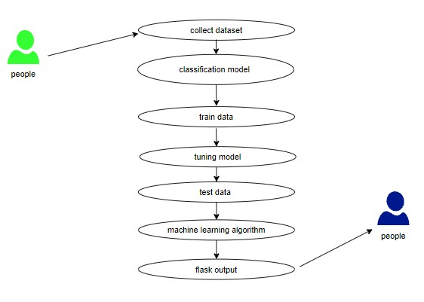
UML DIAGRAM

Slide 8
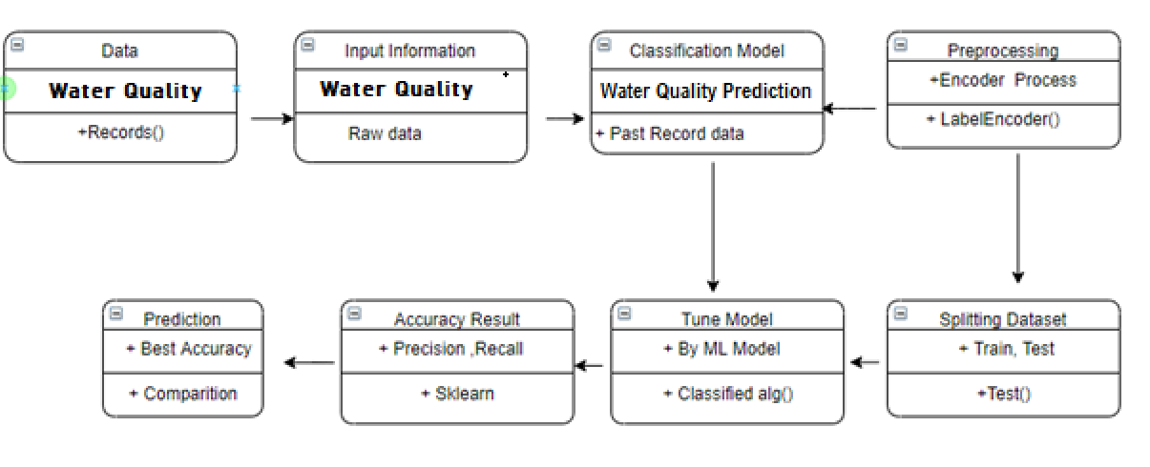
CLASS DIAGRAM

Slide 9
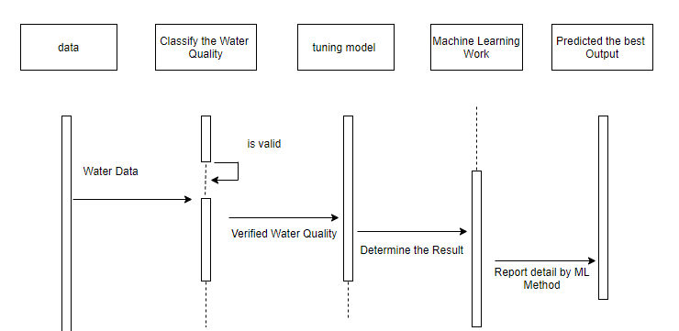
SEQUENCE DIAGRAM

Slide 10
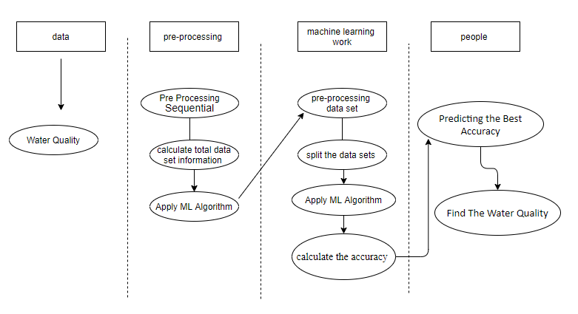
ACTIVITY DIAGRAM

Slide 11
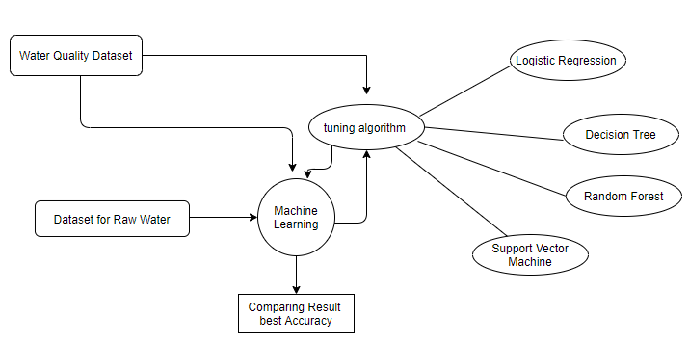
ER DIADGRAM

Slide 12
List of Modules:
Data Preprocessing Technique
Data analysis of visualization
Comparing Algorithm with prediction in the form of best accuracy result
Deployment using Flask

Slide 13
ALGORITHM EXPLANATION

Slide 14
LOGISTIC REGRESSION
It is a statistical method for analysing a data set in which there are one or more independent variables that determine an outcome. The outcome is measured with a dichotomous variable (in which there are only two possible outcomes). The goal of logistic regression is to find the best fitting model to describe the relationship between the dichotomous characteristic of interest (dependent variable = response or outcome variable) and a set of independent (predictor or explanatory) variables. Logistic regression is a Machine Learning classification algorithm that is used to predict the probability of a categorical dependent variable. In logistic regression, the dependent variable is a binary variable that contains data coded as 1 (yes, success, etc.) or 0 (no, failure, etc.).
In other words, the logistic regression model predicts P(Y=1) as a function of X. Logistic regression Assumptions:
Logistic regression predicts the output of a categorical dependent variable. qTherefore the outcome must be a categorical or discrete value. It can be either Yes or No, 0 or 1, true or False, etc. but instead of giving the exact value as 0 and 1, it gives the probabilistic values which lie between 0 and 1.

Slide 15
LOGISTIC REGRESSION
Logistic Regression is much similar to the Linear Regression except that how they are used. Linear Regression is used for solving Regression problems, whereas Logistic regression is used for solving the classification problems.
In Logistic regression, instead of fitting a regression line, we fit an "S" shaped logistic function, which predicts two maximum values (0 or 1).
The curve from the logistic function indicates the likelihood of something such as whether the cells are cancerous or not, a mouse is obese or not based on its weight, etc.
Logistic Regression is a significant machine learning algorithm because it has the ability to provide probabilities and classify new data using continuous and discrete datasets.
Logistic Regression can be used to classify the observations using different types of data and can easily determine the most effective variables used for the classification. The below image is showing the logistic function:

Slide 16
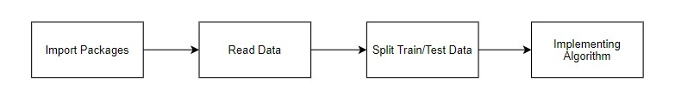
LOGISTIC REGRESSION
MODULE DIAGRAM
GIVEN INPUT EXPECTED OUTPUT
input : data
output : getting accuracy

Slide 17
DECISION TREE
Introduction to Decision Tree
In general, Decision tree analysis is a predictive modelling tool that can be applied across many areas. Decision trees can be constructed by an algorithmic approach that can split the dataset in different ways based on different conditions. Decisions trees are the most powerful algorithms that falls under the category of supervised algorithms.
They can be used for both classification and regression tasks. The two main entities of a tree are decision nodes, where the data is split and leaves, where we got outcome. The example of a binary tree for predicting whether a person is fit or unfit providing various information like age, eating habits and exercise habits, is given below −
In the above decision tree, the question are decision nodes and final outcomes are leaves. We have the following two types of decision trees.

Slide 18
DECISION TREE
Classification decision trees − In this kind of decision trees, the decision variable is categorical. The above decision tree is an example of classification decision tree.
Regression decision trees − In this kind of decision trees, the decision variable is continuous.
Implementing Decision Tree Algorithm
Gini Index
Important Terminology related to Decision Tree
Root Node: It represents the entire population or sample and this further gets divided into two or more homogeneous sets.
Splitting: It is a process of dividing a node into two or more sub-nodes.
Decision Node: When a sub-node splits into further sub-nodes, then it is called the decision node.
Leaf / Terminal Node: Nodes do not split is called Leaf or Terminal node.
Pruning: When we remove sub-nodes of a decision node, this process is called pruning. You can say the opposite process of splitting.

Slide 19
DECISION TREE
Branch / Sub-Tree: A subsection of the entire tree is called branch or sub-tree.
Parent and Child Node: A node, which is divided into sub-nodes is called a parent node of sub-nodes whereas sub-nodes are the child of a parent node.
Decision trees classify the examples by sorting them down the tree from the root to some leaf/terminal node, with the leaf/terminal node providing the classification of the example.
Each node in the tree acts as a test case for some attribute, and each edge descending from the node corresponds to the possible answers to the test case. This process is recursive in nature and is repeated for every subtree rooted at the new node.

Slide 20
RANDOM FOREST
Random Forest is a popular machine learning algorithm that belongs to the supervised learning technique. It can be used for both Classification and Regression problems in ML. It is based on the concept of ensemble learning, which is a process of combining multiple classifiers to solve a complex problem and to improve the performance of the model.
As the name suggests, "Random Forest is a classifier that contains a number of decision trees on various subsets of the given dataset and takes the average to improve the predictive accuracy of that dataset." Instead of relying on one decision tree, the random forest takes the prediction from each tree and based on the majority votes of predictions, and it predicts the final output.
The greater number of trees in the forest leads to higher accuracy and prevents the problem of overfitting.

Slide 21
RANDOM FOREST
Assumptions for Random Forest
Since the random forest combines multiple trees to predict the class of the dataset, it is possible that some decision trees may predict the correct output, while others may not. But together, all the trees predict the correct output. Therefore, below are two assumptions for a better Random forest classifier:
There should be some actual values in the feature variable of the dataset so that the classifier can predict accurate results rather than a guessed result.
The predictions from each tree must have very low correlations.
Why use Random Forest?
Below are some points that explain why we should use the Random Forest algorithm:
It takes less training time as compared to other algorithms.
It predicts output with high accuracy, even for the large dataset it runs efficiently.
It can also maintain accuracy when a large proportion of data is missing.

Slide 22
RANDOM FOREST
The working of the algorithm can be better understood by the below example:
Example: Suppose there is a dataset that contains multiple fruit images. So, this dataset is given to the Random forest classifier. The dataset is divided into subsets and given to each decision tree. During the training phase, each decision tree produces a prediction result, and when a new data point occurs, then based on the majority of results, the Random Forest classifier predicts the final decision. Consider the below image:
MODULE DIAGRAM
GIVEN INPUT EXPECTED OUTPUT
input : data
output : getting accuracy

Slide 23
SUPPORT VECTOR MACHINE
Given a set of training examples, each marked as belonging to one or the other of two categories, an SVM training algorithm builds a model that assigns new examples to one category or the other, making it a non-probabilistic binary linear classifier.
The objective of applying SVMs is to find the best line in two dimensions or the best hyperplane in more than two dimensions in order to help us separate our space into classes. The hyperplane (line) is found through the maximum margin, i.e., the maximum distance between data points of both classes.
Don’t you think the definition and idea of SVM look a bit abstract? No worries, let me explain in details.
Support Vector, Hyperplane, and Margin
The vector points closest to the hyperplane are known as the support vector points because only these two points are contributing to the result of the algorithm, and other points are not. If a data point is not a support vector, removing it has no effect on the model. On the other hand, deleting the support vectors will then change the position of the hyperplane.

Slide 24
SUPPORT VECTOR MACHINE
The dimension of the hyperplane depends upon the number of features. If the number of input features is 2, then the hyperplane is just a line. If the number of input features is 3, then the hyperplane becomes a two-dimensional plane. It becomes difficult to imagine when the number of features exceeds 3.
The distance of the vectors from the hyperplane is called the margin, which is a separation of a line to the closest class points. We would like to choose a hyperplane that maximises the margin between classes. The graph below shows what good margin and bad margin are.
Hard Margin
If the training data is linearly separable, we can select two parallel hyperplanes that separate the two classes of data, so that the distance between them is as large as possible.

Slide 25
SUPPORT VECTOR MACHINE
Soft Margin
As most of the real-world data are not fully linearly separable, we will allow some margin violation to occur, which is called soft margin classification. It is better to have a large margin, even though some constraints are violated. Margin violation means choosing a hyperplane, which can allow some data points to stay in either the incorrect side of the hyperplane and between the margin and the correct side of the hyperplane.
In order to find the maximal margin, we need to maximize the margin between the data points and the hyperplane. In the following session, I will share the mathematical concepts behind this algorithm.
MODULE DIAGRAM
GIVEN INPUT EXPECTED OUTPUT
input : data
output : getting accuracy

